Slide 1
Physics of Ferromagnetism
Weekly Presentation
Ch1. Magnetostatic Phenomena,
Physics of Ferromagnetism (1997), Chikazumi
Khritish Kumar Behera 17125
EECS Dept., IISER Bhopal
1st October 2021

Slide 2

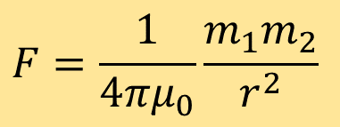

Magnetic Force and Magnetic Field
Force of attraction and repulsion
Assume, magnetic poles on the ends of a magnet
Magnet
Force exerted by poles, Coulomb Forces
$$m_{1},m_{2}:Magnetic Pole Strength$$
Poles
$$F=\frac{1}{4πμ_{0}}\frac{m_{1}m_{2}}{r^{2}}$$
$$r:distance between the pole$$
$$μ_{0}:Permeability of the vacuum (4π×{10}^{−7} Hm^{−1})$$
Region where magnetic poles experiences applied force, Magnetic Field
Magnetic field can be produced by: magnetic poles or electric current

Slide 3
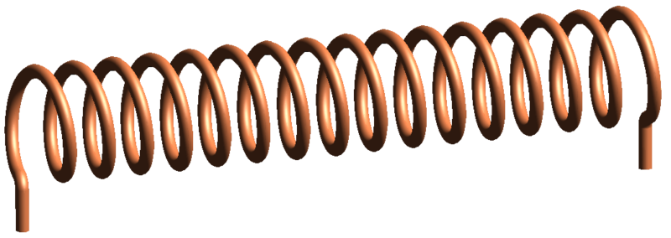
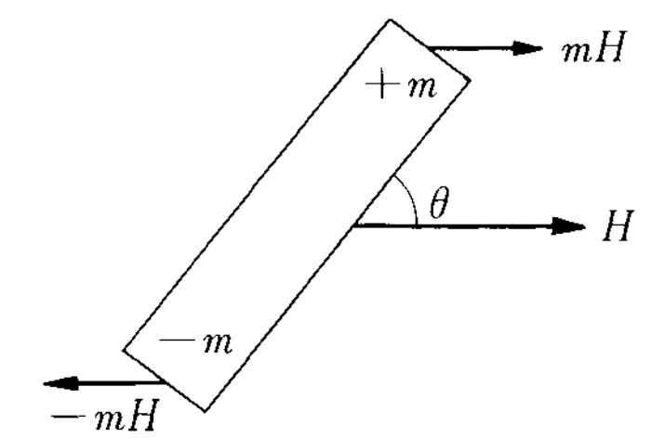
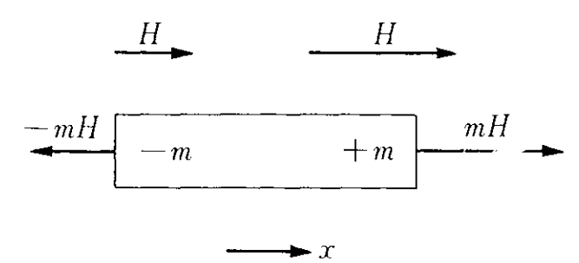
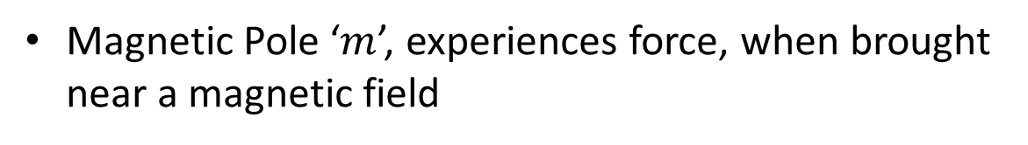



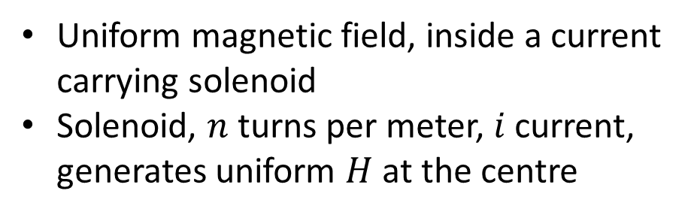





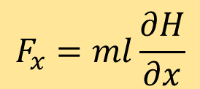
Magnetic Field
$$H$$
Uniform magnetic field, inside a current carrying solenoid
Solenoid, $n$ turns per meter, $i$ current, generates uniform $H$ at the centre
$$i$$
$$H=ni$$
$$i$$
Magnetic Pole ‘$m$’, experiences force, when brought near a magnetic field
$$F=mH$$
$$Uniform H$$
$$Non−uniform H$$
$$F_{x}=ml\frac{∂H}{∂x}$$
$$L=−mHl sin⁡(θ)$$
✓Rotational Motion
✗ Translational motion
✗ Rotational Motion
✓Translational motion

Slide 4
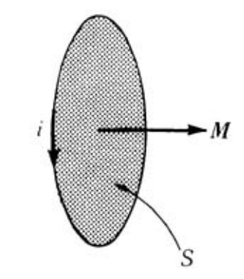


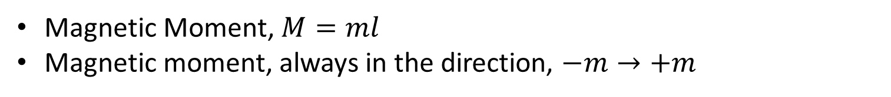



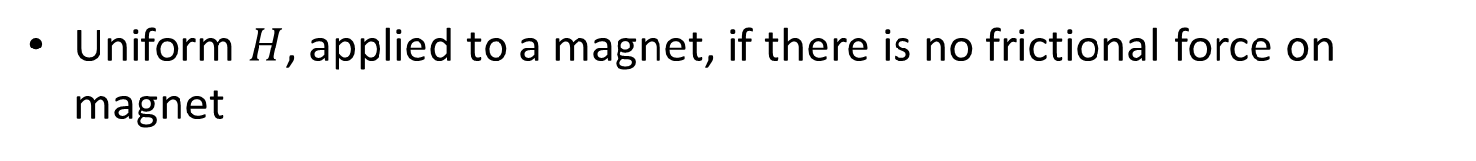
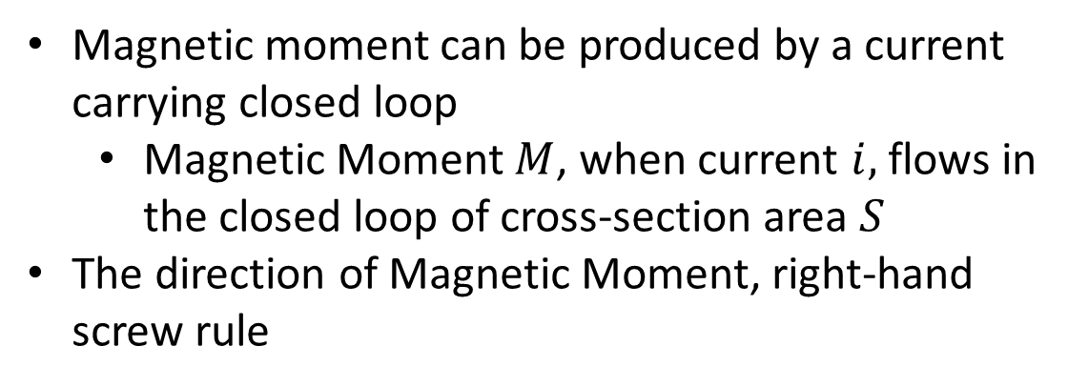
Magnetic Moment
Magnetic Moment, $M=ml$
Magnetic moment, always in the direction, $−m→+m$
$L=−mHl\sin\left(θ\right)→−MHsin(θ)$
$$L=−M×H$$
Uniform $H$, applied to a magnet, if there is no frictional force on magnet
$$U=−MHcos(θ)$$
$$U=−M.H$$
Magnetic moment can be produced by a current carrying closed loop
Magnetic Moment $M$, when current $i,$ flows in the closed loop of cross-section area $S$
The direction of Magnetic Moment, right-hand screw rule
$$M=μ_{0}iS$$

Slide 5
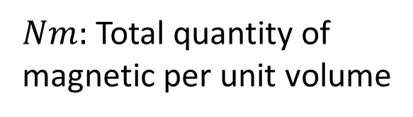
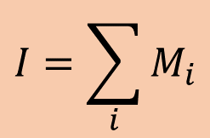

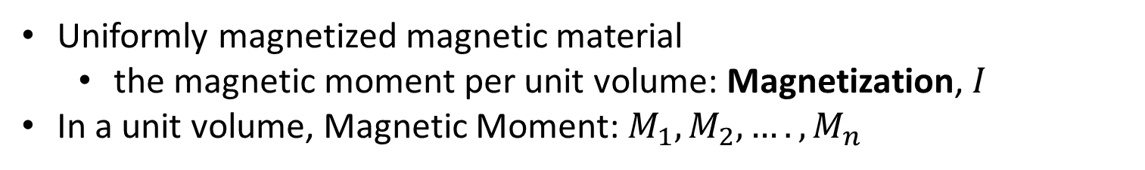
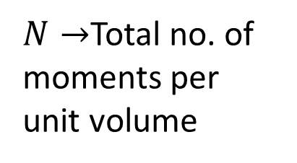
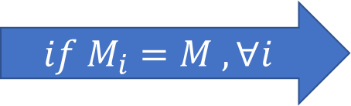
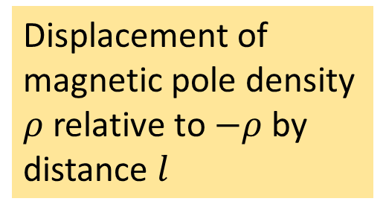


Magnetization
Uniformly magnetized magnetic material
the magnetic moment per unit volume: Magnetization, $I$
In a unit volume, Magnetic Moment: $M_{1}, M_{2}, …., M_{n}$
$$I=\sum_{i}{M_{i}}$$
$$if M_{i}=M , ∀i$$
$N→$Total no. of moments per unit volume
$$I=NM$$
Another interpretation of magnetization,
Displacement of magnetic pole density $ρ$ relative to $−ρ$ by distance $l$
$$I=Nml$$
$$I=ρl$$
$Nm:$ Total quantity of magnetic per unit volume

Slide 6
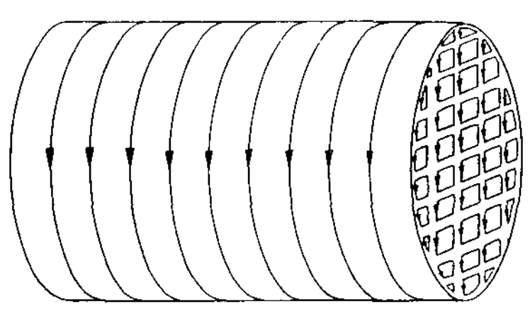

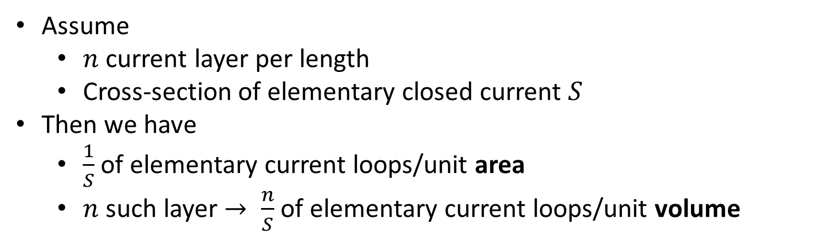




Magnetization
Suppose that magnetic material is filled with many elementary closed current loops
Neighbouring current cancels each other
Only the surface current remains
Assume
$n$ current layer per length
Cross-section of elementary closed current $S$
Then we have
$\frac{1}{S}$ of elementary current loops/unit area
$n$ such layer $→ \frac{n}{S}$ of elementary current loops/unit volume
$$N=\frac{n}{S}$$
$$M=μ_{0}iS$$
$$I=NM$$
$$I=Nμ_{0}iS$$
Magnetization of a closed current loop
Magnetization
$$I=μ_{0}ni$$

Slide 7
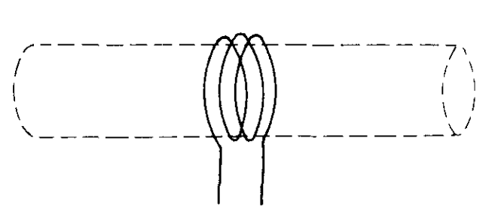

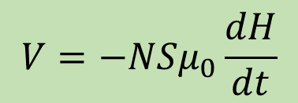
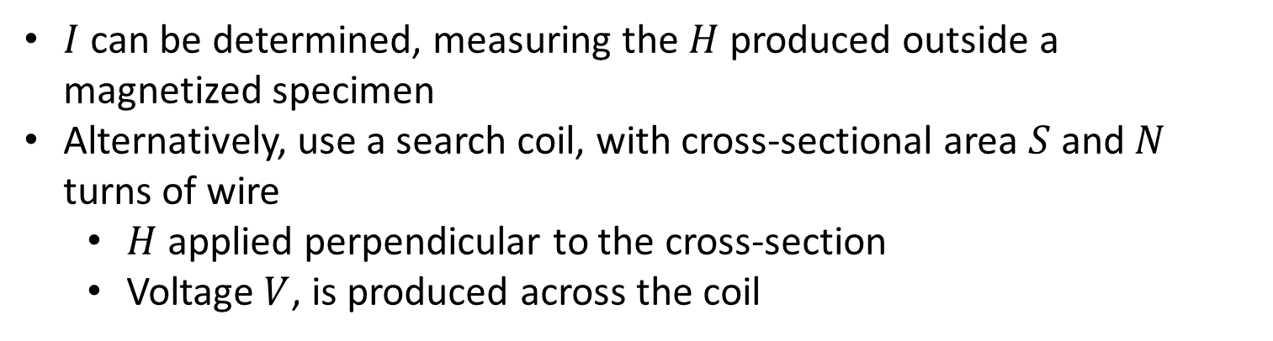
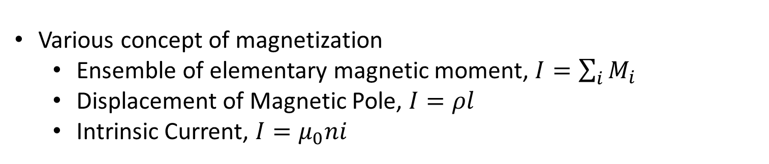
Magnetization
$$I=μ_{0}H$$
Comparing, $I=μ_{0}ni$ and $H=ni$
Various concept of magnetization
Ensemble of elementary magnetic moment, $I=\sum_{i}{M_{i}}$
Displacement of Magnetic Pole, $I=ρl$
Intrinsic Current, $I=μ_{0}ni$
$I$ can be determined, measuring the $H$ produced outside a magnetized specimen
Alternatively, use a search coil, with cross-sectional area $S$ and $N$ turns of wire
$H$ applied perpendicular to the cross-section
Voltage $V$, is produced across the coil
$$V=−NSμ_{0}\frac{dH}{dt}$$
Acc. to the Law of Electromagnetic Induction

Slide 8

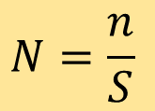
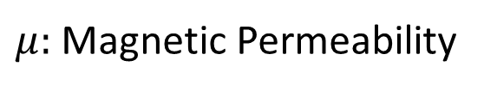
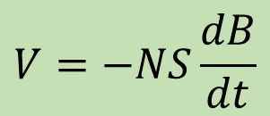

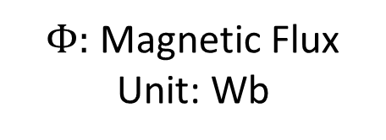

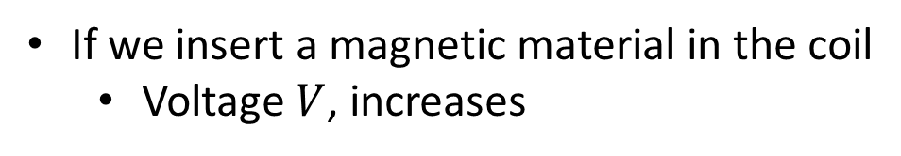
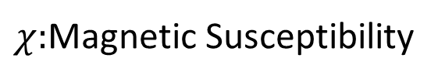

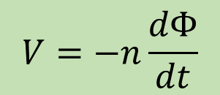
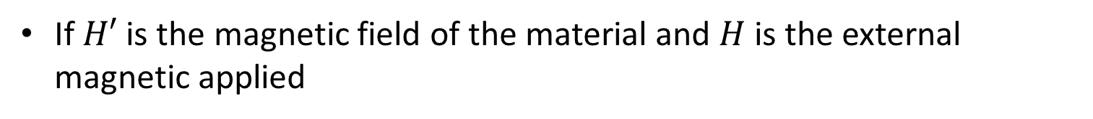


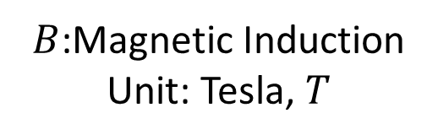
Magnetization
If we insert a magnetic material in the coil
Voltage $V$, increases
$$V=−NS\frac{dB}{dt}$$
$B$:Magnetic Induction
Unit: Tesla, $T$
If $H′$ is the magnetic field of the material and $H$ is the external magnetic applied
$$B=I+μ_{0}H$$
$$B=μ_{0}(H+H^{′})$$
$$I=μ_{0}H′$$
Product of $B$ and $S:$ Magnetic Flux
$$Φ=BS$$
$Φ:$ Magnetic Flux
Unit: Wb
$$N=\frac{n}{S}$$
$$V=−n\frac{dΦ}{dt}$$
$B=I+μ_{0}H$, We can say that $I$ is proportional to $H$
$$I=χH$$
$χ:$Magnetic Susceptibility
$B=\left(χ+μ_{0}\right)H=μH$
$μ:$ Magnetic Permeability

Slide 9
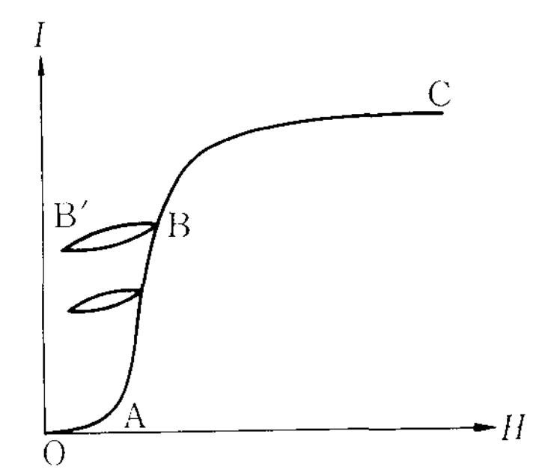
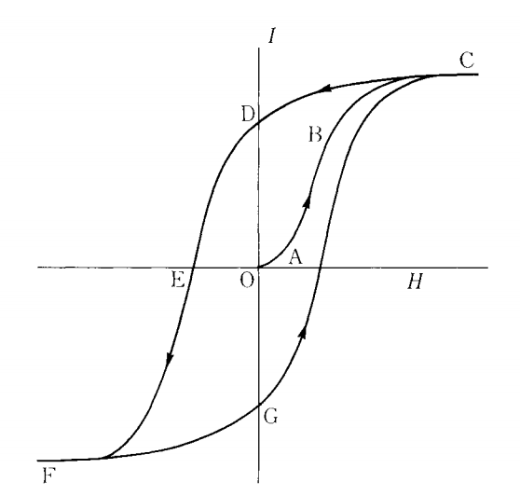
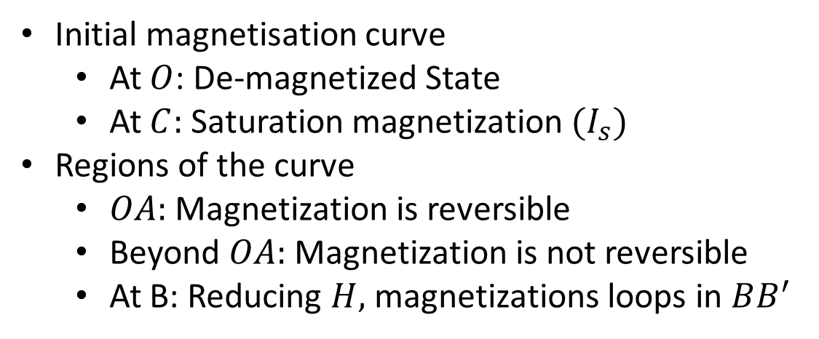
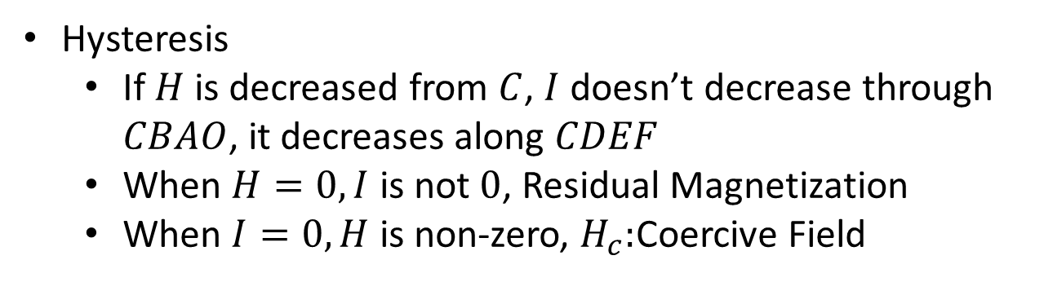
Hysteresis
Ferromagnetic materials can be highly magnetized by magnetic field
Magnetization changes by changing magnetic field
Initial magnetisation curve
At $O$: De-magnetized State
At $C:$ Saturation magnetization ${(I}_{s})$
Regions of the curve
$OA:$ Magnetization is reversible
Beyond $OA:$ Magnetization is not reversible
At B: Reducing $H,$ magnetizations loops in $BB^{′}$
Hysteresis
If $H$ is decreased from $C$, $I$ doesn’t decrease through $CBAO$, it decreases along $CDEF$
When $H=0, I$ is not $0$, Residual Magnetization
When $I=0, H$ is non-zero, $H_{c}:$Coercive Field

Slide 10
Next Presentation

Slide 11
Physics of Ferromagnetism
Weekly Presentation
Ch1. Magnetostatic Phenomena,
Physics of Ferromagnetism (1997), Chikazumi
Khritish Kumar Behera 17125
EECS Dept., IISER Bhopal
2nd October 2021

Slide 12
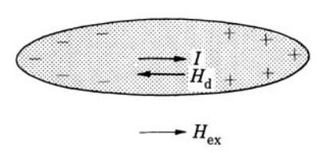

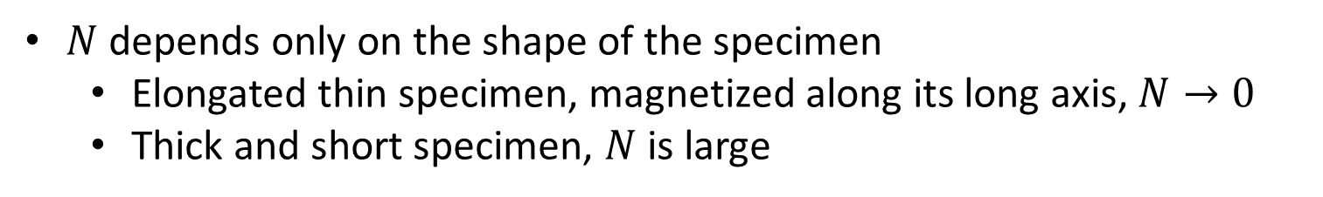
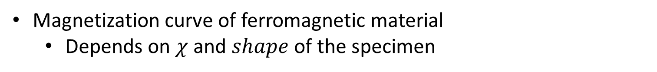
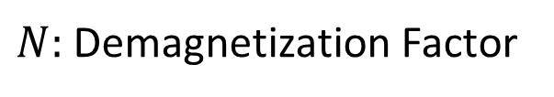
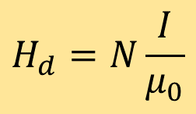
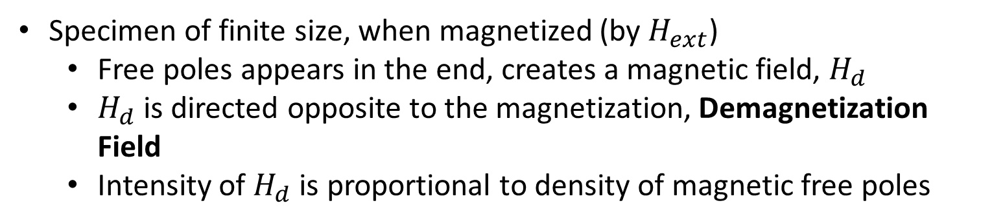
Demagnetization
Magnetization curve of ferromagnetic material
Depends on $χ$ and $shape$ of the specimen
$$I=χH$$
Specimen of finite size, when magnetized (by $H_{ext}$)
Free poles appears in the end, creates a magnetic field, $H_{d}$
$H_{d}$ is directed opposite to the magnetization, Demagnetization Field
Intensity of $H_{d}$ is proportional to density of magnetic free poles
$$H_{d}=N\frac{I}{μ_{0}}$$
$N:$ Demagnetization Factor
$N$ depends only on the shape of the specimen
Elongated thin specimen, magnetized along its long axis, $N→0$
Thick and short specimen, $N$ is large

Slide 13
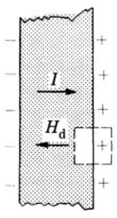
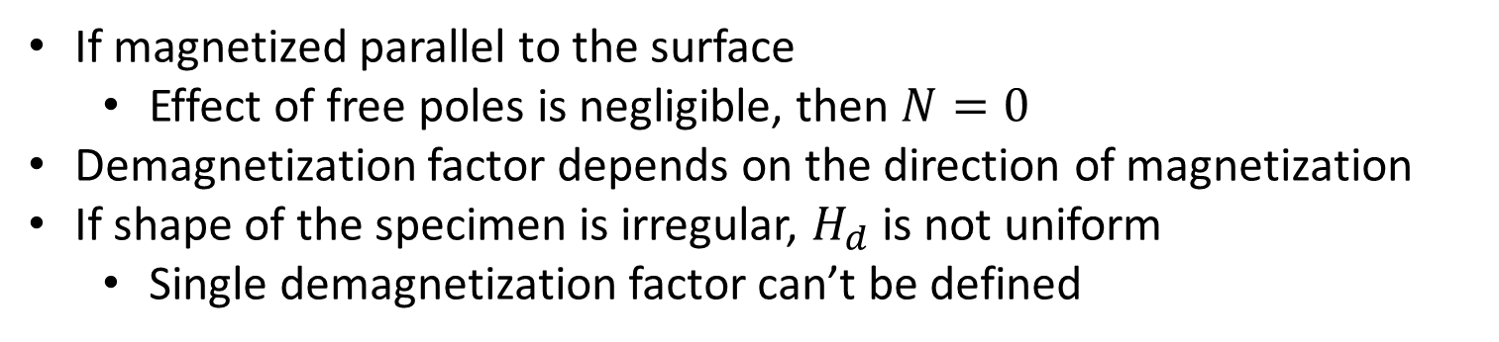

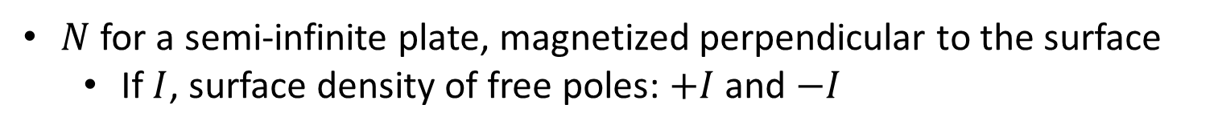
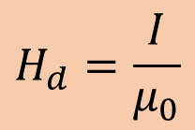
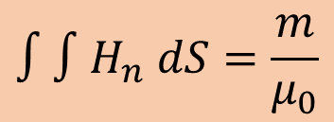
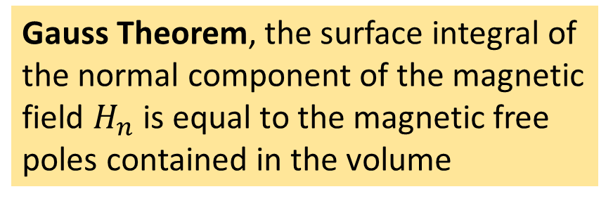
Demagnetization
$N$ for a semi-infinite plate, magnetized perpendicular to the surface
If $I$, surface density of free poles: $+I$and $−I$
Gauss Theorem, the surface integral of the normal component of the magnetic field $H_{n}$ is equal to the magnetic free poles contained in the volume
$$∫∫H_{n} dS=\frac{m}{μ_{0}}$$
Assuming there is no field outside, except for the external field
$$H_{d}=\frac{I}{μ_{0}}$$
$$N=1$$
If magnetized parallel to the surface
Effect of free poles is negligible, then $N=0$
Demagnetization factor depends on the direction of magnetization
If shape of the specimen is irregular, $H_{d}$ is not uniform
Single demagnetization factor can’t be defined

Slide 14
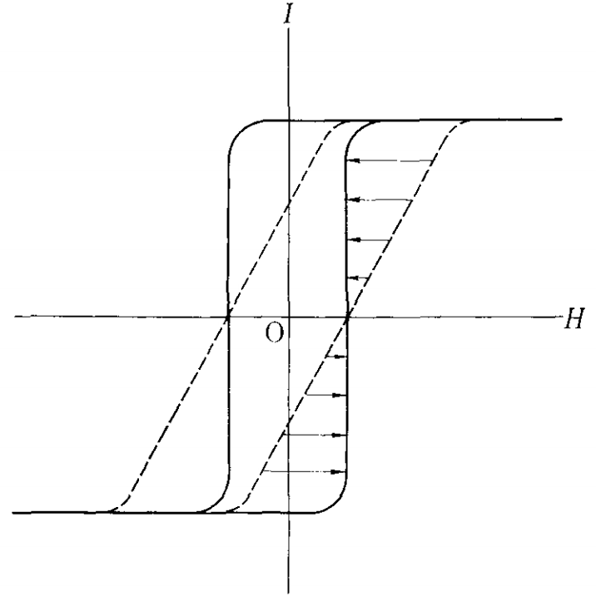





Demagnetization
Demagnetization factor 3 principal axis
$N_{x}+N_{y}+N_{z}=1$
For Sphere, $N_{x}=N_{y}=N_{z}=N$
$$N=\frac{1}{3}$$
Semi-infinite plane magnetized perpendicular to surface
$$N_{x}=N_{y}=0, N_{z}=N$$
$$N=1$$
Plot magnetization vs Ext. field
The shape of the curve is sheered
The actual field acting on the material < external field
For Long cylinder magnetized perpendicular to long axis
$N_{z}=0$, $N_{x}=N_{y}=N$
$$N=\frac{1}{2}$$
$$H_{eff}=H_{ex}−N\frac{I}{μ_{0}}$$

Slide 15






Demagnetization
Sheared Magnetization Curve $→$ True Curve demagnetizing correction or shearing correction
After correction, the magnetization curves $→$ more upright form
With large $N$, high field is required to magnetize the material
Field inside a cavity, material magnetized to $I$
Free poles distribute on the surface of cavity
With same $I$, surrounding the cavity except the poles are opposite sign
$$H_{in}=N\frac{I}{μ_{0}}$$
$$H_{in}=\frac{I}{3μ_{0}}$$
For Sphere
Lorentz Field

Slide 16
Next Presentation

Slide 17
Physics of Ferromagnetism
Weekly Presentation
Ch1. Magnetostatic Phenomena,
Physics of Ferromagnetism (1997), Chikazumi
Khritish Kumar Behera 17125
EECS Dept., IISER Bhopal
8th October 2021

Slide 18
















Magnetic Circuit
Specimen of irregular shape $→$ Non-uniform demagnetizing field, Complicated magnetization distribution
Similar Situation
Dielectric material of irregular shape$→$ Distribution of free electric charge
Absence of true electric charge
Magnetostatics
$$∇D=0$$
$$∇B=0$$
$D$: Elec. Flux density
$$B=μH=−μΔφ_{m}$$
$$D=εE=−εΔφ$$
$$Δ(μΔφ_{m})=0$$
$φ$: Elec. potential
$$∇\left(εΔφ\right)=0$$
Distribution of elec. Current density in conducting medium
$ε$is constant
$$∇\left(Δφ\right)=0$$
$$∇i=0$$
$$i=σE=−σΔφ$$
$$Δφ=0$$
Laplace Equation
$$Δ(σΔφ)=0$$

Slide 19










Magnetic Circuit
Conductor surrounded by insulator
No matter how complicated shape of wire $→E$lec. Current is contained in the wire
Magnetic material, with high permeability forms a circuit
Magnetic flux density is fully confined inside the magnetic material
Magnetic circuit $↔$ Electric Circuit
Direction of magnetization $→$parallel to the surface of magnetic material
If $B$ is uniform
$$i=σE=−σΔφ$$
$$B↔i$$
$$Φ=BS$$
Comparing
$$B=μH=−μΔφ_{m}$$
$$σ↔μ$$

Slide 20











Magnetic Circuit
Correspondingly,
$$R=∫\frac{ds}{σS}$$
$$R_{m}=∫\frac{ds}{μS}$$
Electric Circuit
Magnetic Circuit
Resistance
Reluctance
Electric Circuit
Magnetic Circuit
E$=∮E.dl$
$$V_{m}=∮H_{s}ds$$
Electromotive Force
Magnetomotive Force
When magnetic circuit , magnetized by an electric current $i$, flows in coil of $N$ turns around the circuit
$$∮H_{s}ds=Ni$$
$$V_{m}=Ni$$
Amperes Theorem

Slide 21



Magnetic Circuit
$$V_{m}=Ni$$
$$V_{m}=Ni=∮H_{s}ds=∮\frac{B}{μ}ds=∮\frac{Φ}{μS}ds=Φ∮\frac{ds}{μS}=ΦR_{m}$$
This relation is similar to Kirchhoff’s second law of electric circuits
$$V=iR$$

